Slide 1
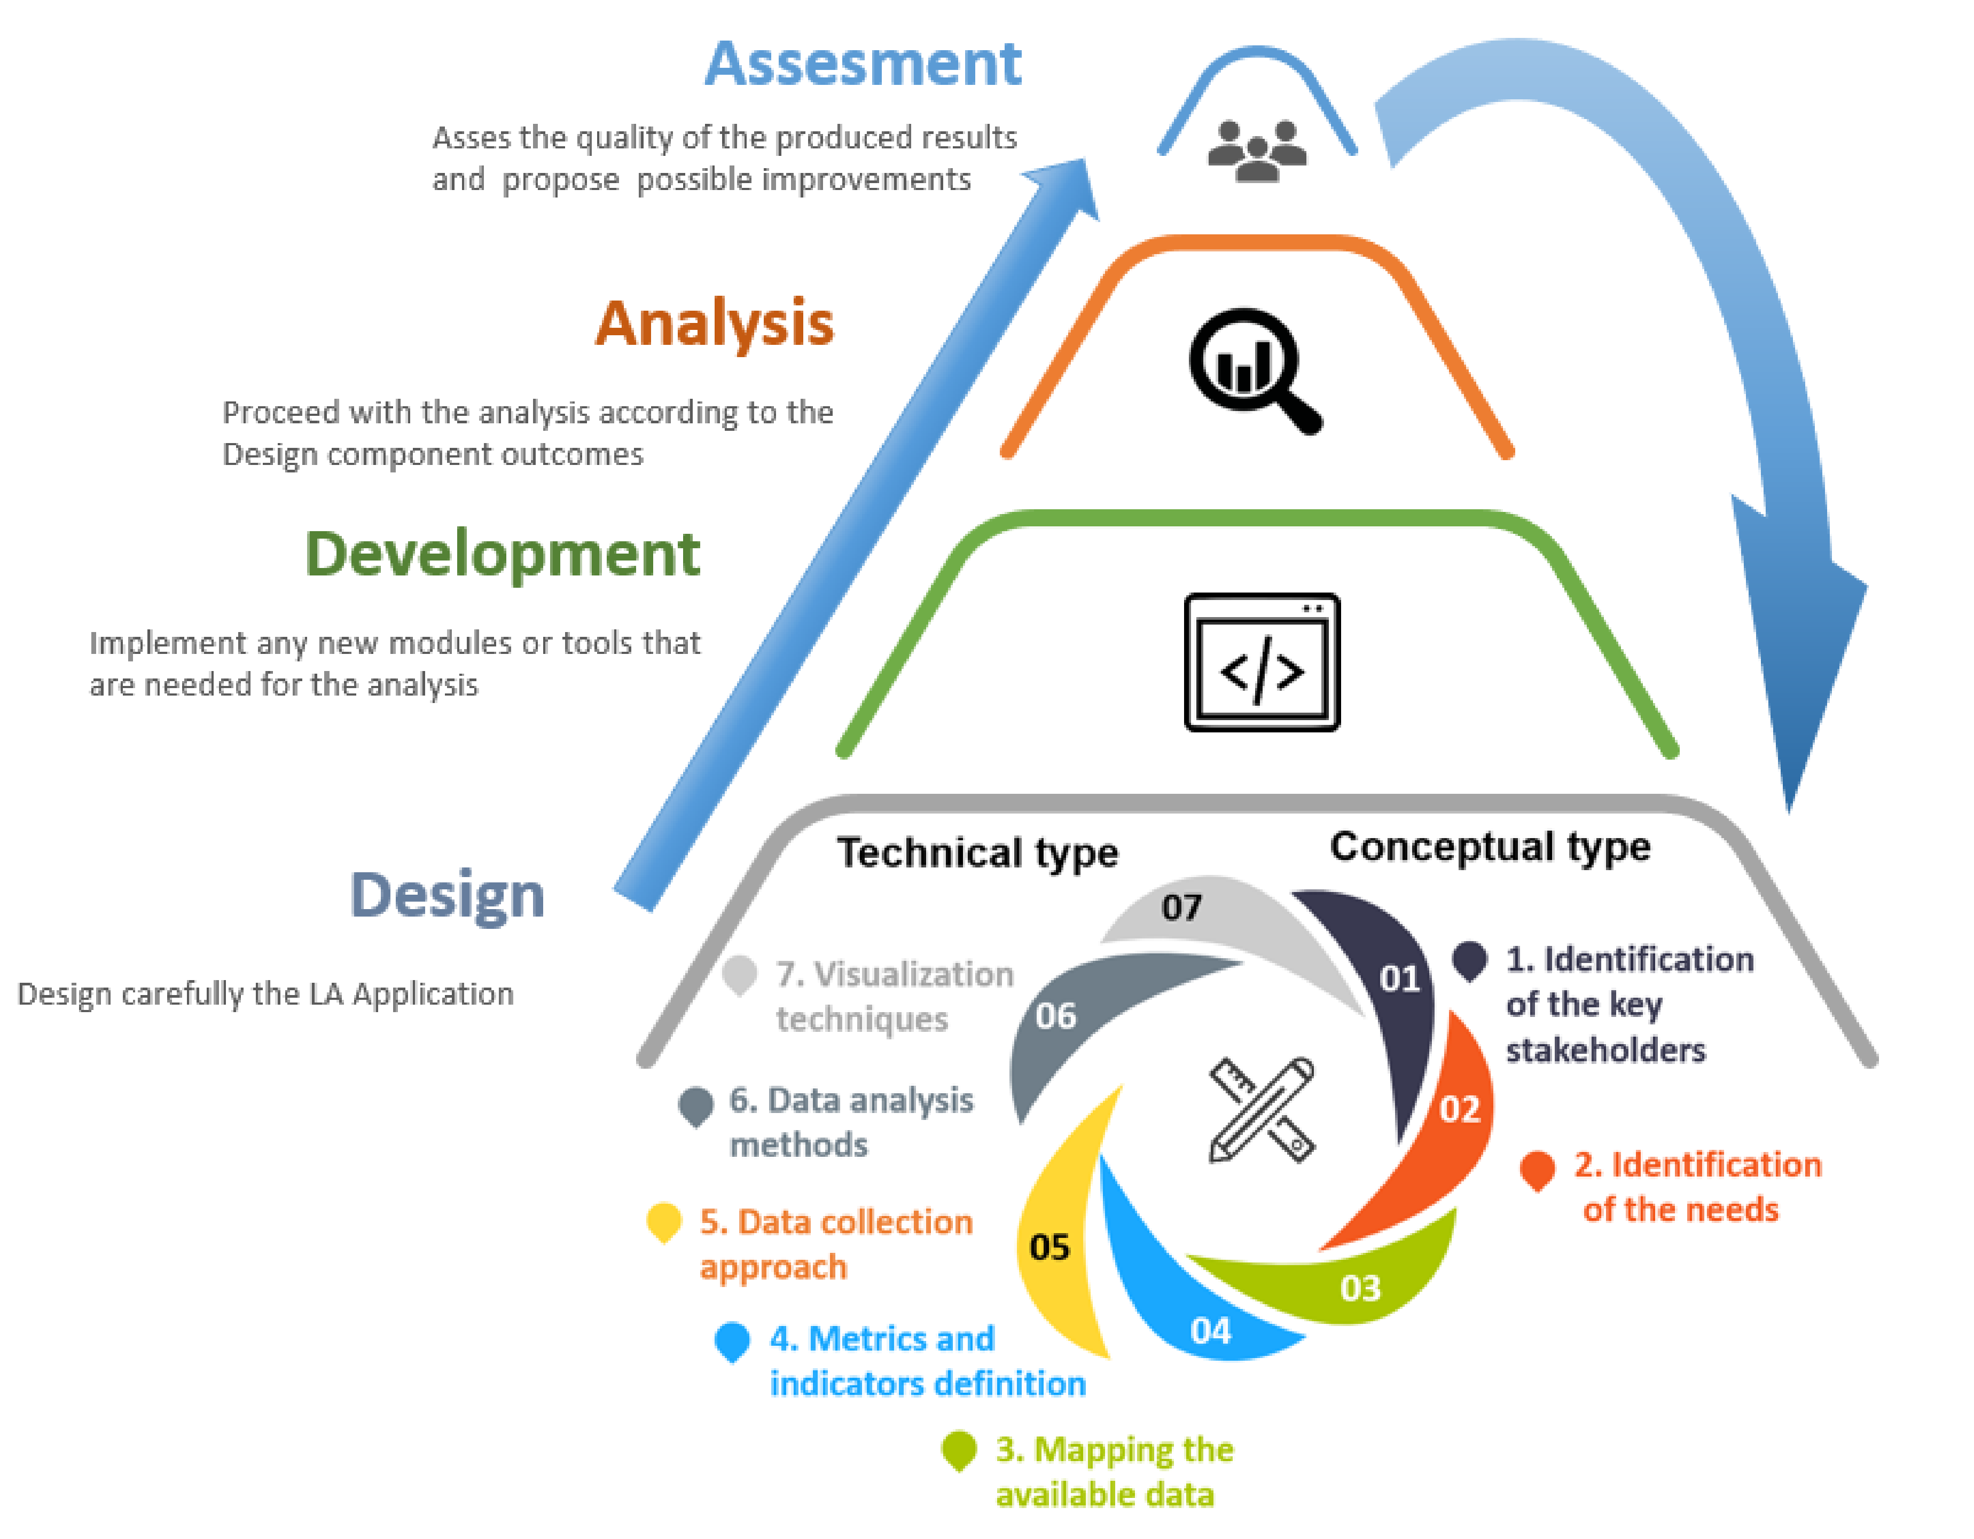
Outputs and visualization (in app)
PBI/other
Interim prototype implementation
Full Brewdat implementation
Analytics Playground brain
Data transformation and pre-processing
API
Temporary storage (SQL, RDBMS)
Brewdat Data Portal
Knowledge graph/semantic layer
Other sources (GCP)
Source systems/ADLS Gen2/S3

Slide 3
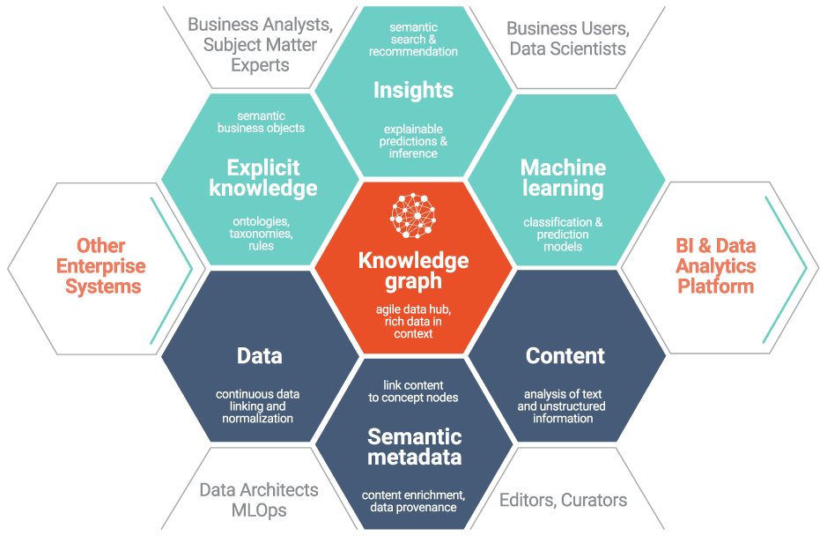

Slide 4
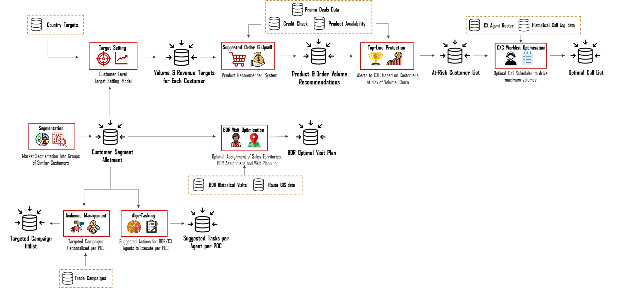

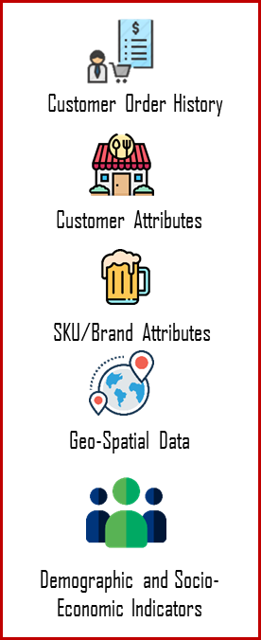



Commercial Analytics Brain
Solution Architecture
Input Data
End Points

Slide 5

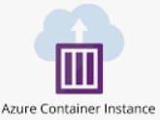



































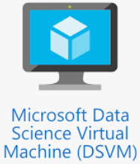

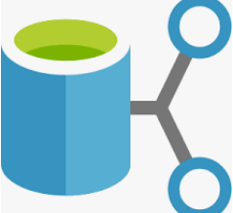





Sources
Data ingestion
Data processing and integration
Data storage
Data science
Data consumption
20
✓
✓
Data APIs
1
6
Real-time processing
9
16
Real-time data feeds
Real-time data store
Model mgmt
Super hot
Hot/warm
Super hot
Data security
21
Snowflake – API for PBI
Analysis/ visualization/ reporting
Hot data
LZ>HZ>TZ
✓
10
11
17
Zone mart
Online DB
Analytics mart (AZ)
Internal batch DBs (pull)
7
✓
22
2
Orchestration
BI Catalog
12
13
18
Knowledge graph (SQL)
EDW (TZ)
AI/ML runtime & processing
23
✓
✓
Interactive SQL
3
Internal batch DBs (push)
✓
14
24
✓
4
8
Storage layer (HZ)
19
Data portal
✓
Interna/ external batch feeds (push)
Batch processing
Spin up cluster
Process
Shut down cluster
✓
Experimentation
✓
5
25
Interna/ external batch feeds (pull)
15
Data shares
Landing zone and archive
✓
Azure data/file share
26
27
28
29
30
31
Metadata/log/audit
Security management
Document management
Code repositories
CICD/IAC
M&E
Content Component Management System - paligo.com and xyleme.com, DITA (IBM)
Notes:
GS

Slide 6
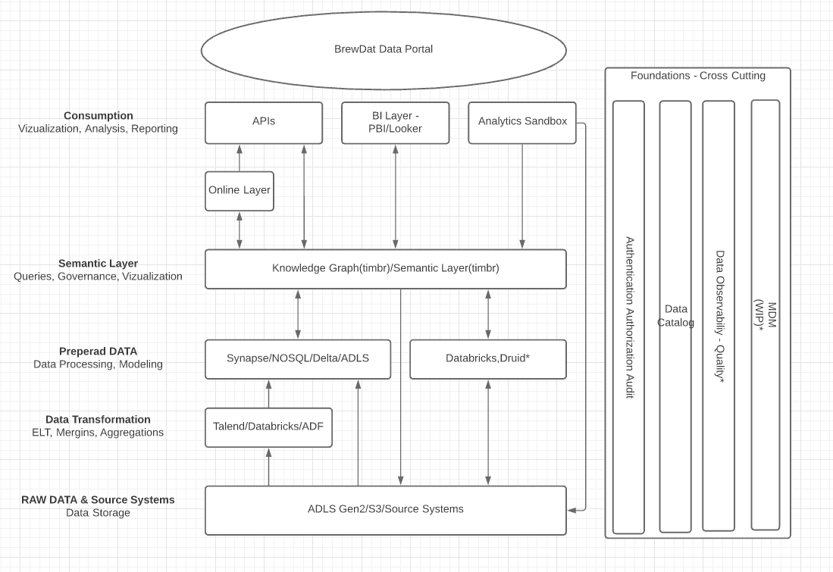
Conceptual Diagram
Data portal

Slide 7
